Slide 1
CS M117
Computer Networks: The Physical Layer
MARCH 29; SPRING 2016
Instructor Revaz Dzhanidze
revazd@cs.ucla.edu
revazd@ee.ucla.edu
Ph: 4-4579; 3732K BH
TA:
(1A &1B):Jingyu Liu; ljy1681@gmail.com
Ph: 5-8659; 3704 BH
(1C): R. Vince Rabsatt; rrabsatt@CS.UCLA.EDU
Ph: 5-8659; 3704 BH
(1D)Yanzhe Liu; nickliuyanzhe@gmail.com
Ph: 5-8659 3704 BH

Slide 2
Office Hours (tentative)
Professor:
11:00-1:50 am T/R, 3704 BH / 3732K BH
TA Lab 1A. 11:00-12:00 am Mondays 3704 BH Lab 1B 12:00-1:00 pm Mondays 3704 BH Lab 1C 1:00-2:00 pm Mondays 3704 BH Lab 1D 12:00-1:00 pm Mondays 3704 BH Additional lab time may be scheduled by appointment with the TA.
The TA may announce additional lab time
Newsgroup and Website
https://ccle.ucla.edu/course/view/16S-COMSCIM117-1

Slide 3
Course Objectives
To provide fundamental knowledge of the theory underlying wireless data communication systems.
To provide hands-on experience by performing a series of wireless laboratory experiments with a number of important laboratory instruments.
To gain experience in preparing formal technical project and report based upon series of laboratory experiments and special experiments using set of wireless communication network.
CS M117 course uses some knowledge of materials
obtained in one of the following classes:
SCI 31, 33,118 or EL 132B

Slide 4
CS M117 is a 4 unit course.
Workload
Weekly
2 hours lecture
2 hours homework
2 hours lab experiment
2 hours report
2 hours outside study
2 hours project
No Midterms, No Finals

Slide 5
Lab Experiments
Laboratory Experiments (Wednesdays):
Lab 1 – AM, PM & Frequency modulation
Lab 2 - 802.11b Wireless LAN
Lab 3 – 802.15 Bluetooth communications
PJ. Lab– Special Wireless Experiments
(SWE)

Slide 6
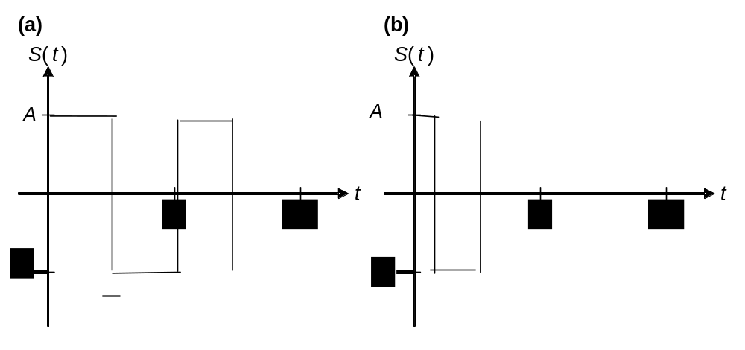
HW (Prelab) Sketch
Pre-Laboratory Home Work #1; (Due 04/12/09).
Students Name____________________________
Signals in Time and Frequency Domains
1) Draw plots of amplitude versus time for the following rectangular signals with period T and amplitude A:
(a) Duty cycle d = 50% (also called a “square wave”)
(b) Duty cycle d = 25%

Slide 7
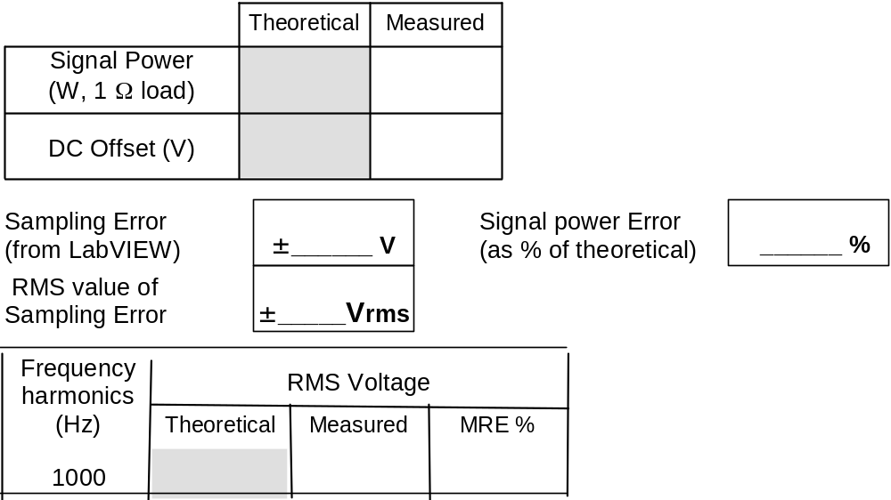
RDS Sketch
Part A: Sine Wave
Signal Amplitude = 2 V (from -2V to +2V)
Fundamental Frequency: ffund = 1000 Hz
DC Offset = 0 V

Slide 8
Quiz Test Sketch
(The quiz is more conceptual than computational).
CS M117
Multiple-Choice
b) Ability to design and conduct experiments, as well as to analyze and interpret data;
19. Before data can be transmitted, they must be transformed to _______.
a. Periodic signals b. Electromagnetic signals
c. Aperiodic signals d. Low-frequency sine waves
31. As frequency increases, the period ________.
a. Decreases b. Increases
c. Remains the same d. Doubles

Slide 9
Report
“Wireless Data Transmission”
Chien _ _ _ _
Report Title Page Sample
CS M117
Winter 14
Partners:
Alexander _ _ _ _
Xiaohang _ _ _ _

Slide 10
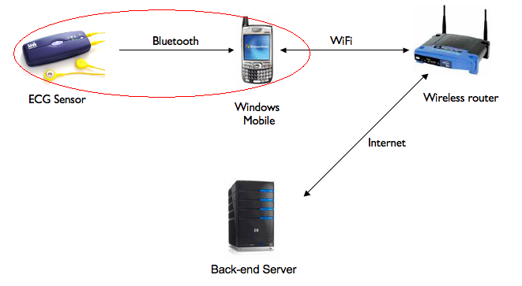
Abstract
Report is implementing a mobile application that receiver medical data (electrocardiogram/ECG) from the Alive heart-monitoring sensor through Bluetooth and send the data to a server through TCP/IP.
Our Team is responsible for retrieving medical data from the ECG sensor.

Slide 11
Grading
Grading:
Homework (HW) (3) = 20%
Lab Report (1) = 20%
Project (1) = 50%
Quiz Test (1) = 10%
RDS (2) P., No P.
Final Grade (FG) 100%

Slide 12
Grading
Conversion of a numerical scores to the letter grades
A+ | A | A- | B+ | B | B- | C+ | C | C- | D
[100-97] | (97-94] | (97-91] | (97-87] | (87-84] | (84-81] | (81-77] | (77-74] | (74-71] | (71>

Slide 13
Recommended References
M. Gerla, R. Dzhanidze: Course Notes for CS 117. 2016. 1081 Westwood Blvd.- Special needs Entrance / 1080 Broxton Av.-Main Entrance; (310) 443-3303
A.S. Tanenbaum, “Computer Networks”, Prentice Hall, 2002, Fourth Edition, ISBN 0-13-066102-3
B.A. Forouzan. “Data Communications and Networking”, Mc-Graw Hill Higher Education, 2004, Third Edition. ISBN 0-07-292005-X.
Materials on CS M117 course Web Site

Slide 14
CS 117: Project List

Slide 15
Proposed project: by choice:
Project #1 “Health. Net
Connecting Patients & Doctors”,
Project #2 “Gateway System Implementation”
(These projects are developed as part of Special Wireless Lab Experiments)

Slide 16
CS 117 Project Grading Policy
Project proposal Presentation – 15%
Attendance – 10%
  You can absent up to two times.
Final Presentation – 35%
  Group presentation; all member will participate; up to 15 minutes
Final Report – 40%

Slide 17
 | Lectures Tuesday. 2:00-3:50 pm 3400 BH |  | Lab: Group 1A, 1B, 1C; 3704 1A: Wed. 10:00-11:50 am 1B: Wed. 12:00-1:50 pm 1C: Wed. 2:00-3:50 pm | Lectures Thursday. 2:00-3:50 pm 3400 BH
1 | Introduction to CS M117 class |  | Lab Training exercise March 30^{eth} | Lec.1. AM, PM, FM; (instr.) (Prelab HW1, due 04/06) Computer networks, (Read.)
 | Intro to the wireless projects March 29th |  |  | Project proposed by TA March 31st
2 | Lec.2. Wireless Channel. Ad-Hoc Networks (Read.) |  | Lab #1 AM, FM & PM RDS* 1 due on 04/13 April 6th | Lec.3. Wireless LAN (Prelab HW2, due) 04/13)
 | Project proposed by students April 5th |  |  | Proposed project discussion April 7th
3 | L.4. BT PAN. (instr.) (Prelab HW3, due 04/20) |  | Lab # 2 (W LAN) RDS* 2 due on 04/20 April 13th | Equipment handed out, Group 1A, 1B; 2:00-3:00 1C; 3:00-3:50 LAB ROOM April 14th
 | Project Assignments. Teams formed April 12th
4 | Final Project Assignments April 19th |  | Lab # 3 BT PAN REPORT due on 04/27 April 20^{eth} | SWE* April 21st
5 | SWE* April 26th |  | SWE* April 27th | Discussion of projects April 28th
6 | SWE* for Project With tutor supervision PROJECTS Due 06/01- -06/02 | SWE* May 3rd | SWE* May 4th | SWE* May 5th
7 |  | SWE* May 10th | SWE* May 11th | SWE* May 12th
8 |  | SWE* May 17th | SWE* May 18th | Concluding Lecture (instr.) May 19th
9 |  | SWE* May 24th | SWE* May 25th | Quiz Test May 26th
10 |  | Project Presentation May 31st | Project Presentation June 1st | Project Presentation June 2nd

Slide 18
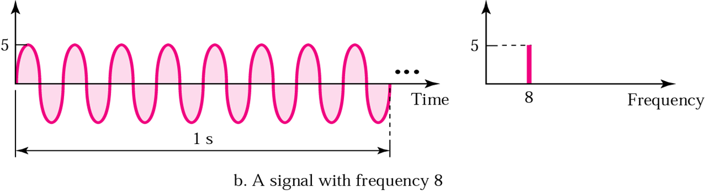
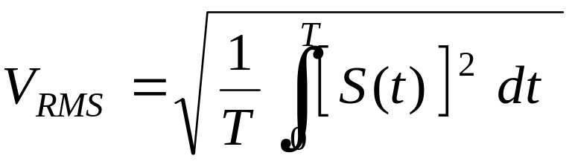
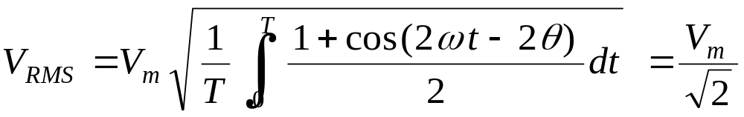
Time and frequency domains
Volt
rms
3.55
8
Frequency

Slide 19
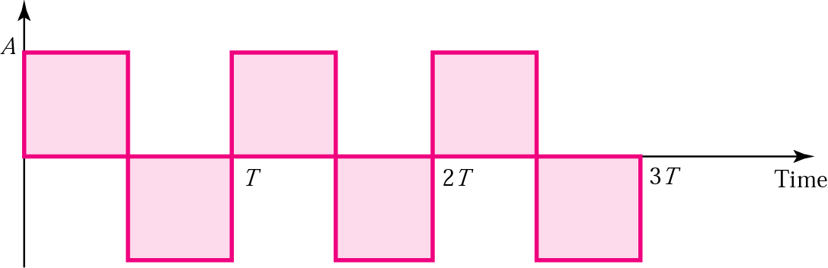
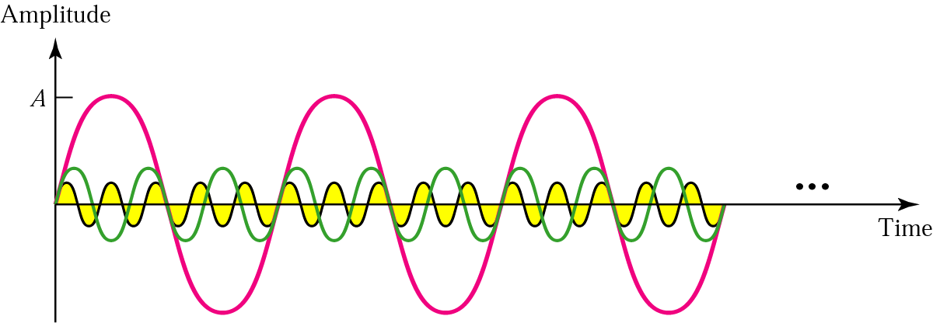
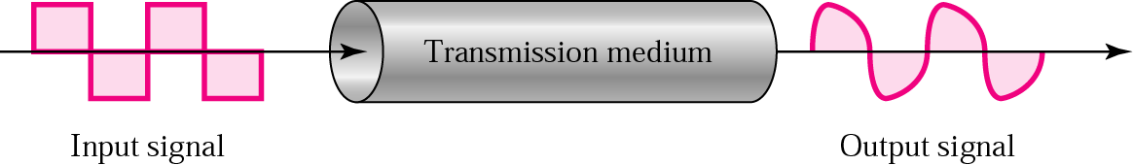
Square wave
Three harmonics
Signal corruption

Slide 20
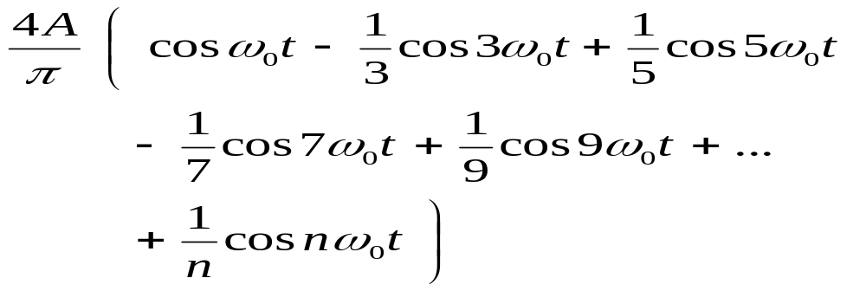
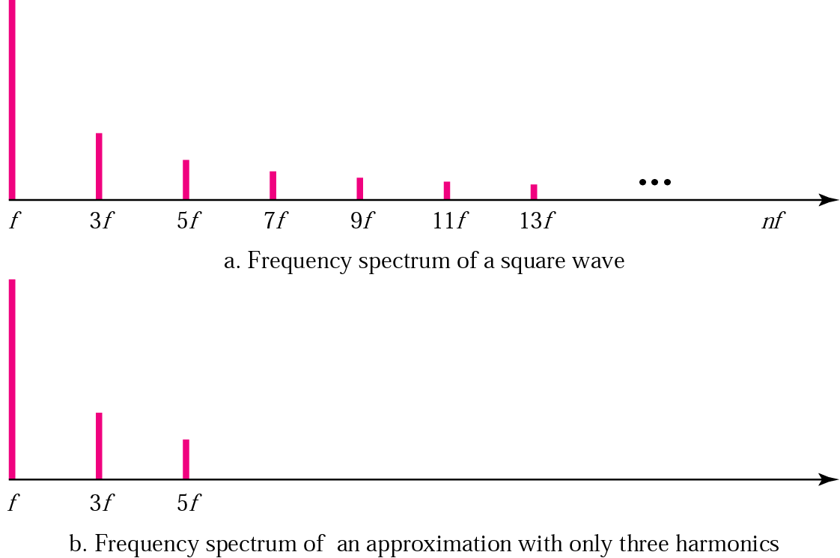
rms
rms
Frequency

Slide 21
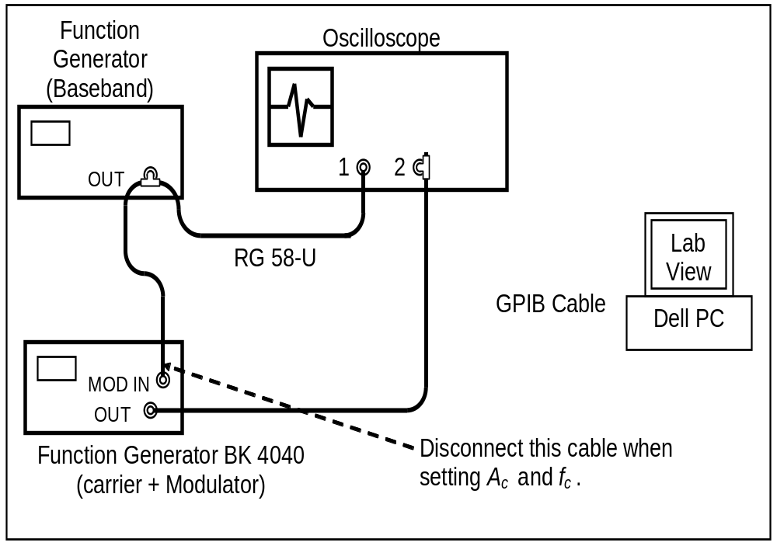

Slide 22
Modulation; BK 4040 Function Generator
Frequency settings
Frequency monitor
Internal Shift =+3.8V; +4V
Amplitude
Mod %
MOD ON/OFF
AM
FM
IN
OUT

Slide 23
Spectrum Analyzer
operate
Run
Number pasted on PC
Instrument # GPIB: 01
RMS
Volt
Frequency
Time
Student name:
Part:
Sampling accuracy:

Slide 24
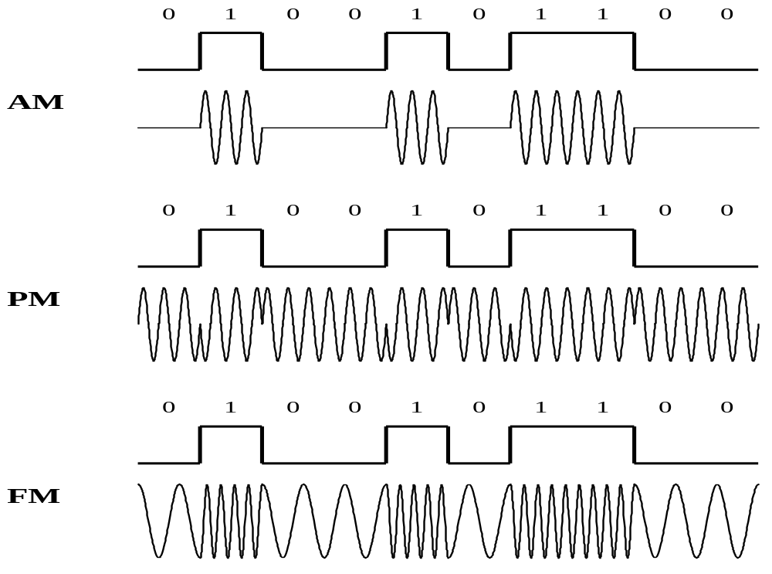

Slide 25
THANK YOU!

